Slide 1
JAVA I/O
File handling API

Slide 2
Stream
Java uses this term as a sequence of data in bytes that streams in or out of program
3 java’s main streams created automatically:
1. System.out: standard output stream
2. System.in: standard input stream
3. System.err: standard error stream
Java i/o api
Source: https://javapoint.com

Slide 3
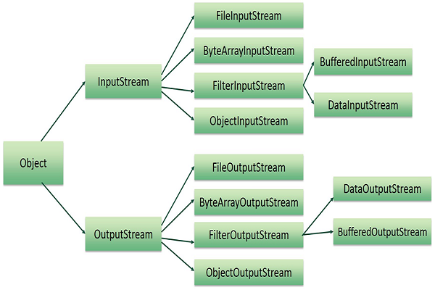
Java Streams
There are plenty of streams that java provides for almost every purposes
Java i/o api
Source: https://tutorialspoint.com

Slide 4
File class
an abstract representation of file and directory pathnames
It provide tools for file system and directory management
Java i/o api

Slide 5
FileInputStream
Bytes Streaming
Java file handling api provides various ways of reading form and writing into binary files
This class allows users to read from binary files
FileOutputStream
This class allows users to write into binary files
Java i/o api

Slide 6
FileReader
Character Streaming
Handling text files or manipulating them is also possible with follow classes
This class allows users to read from text files
FileWriter
This class allows users to write into text files
Java i/o api

Slide 7
FileInputStream
Bytes Streaming
Java file handling api provides various ways of reading form and writing into binary files
This class allows users to read from binary files
FileOutputStream
This class allows users to write into binary files
Java i/o api

Slide 8
Streaming vs Buffering
Click here for more info :}
Java i/o api

Slide 9
Java non-blocking I/O(nio)
Click here for more info :}
Java i/o api

